Slide 1

Customer Engagements

Slide 2
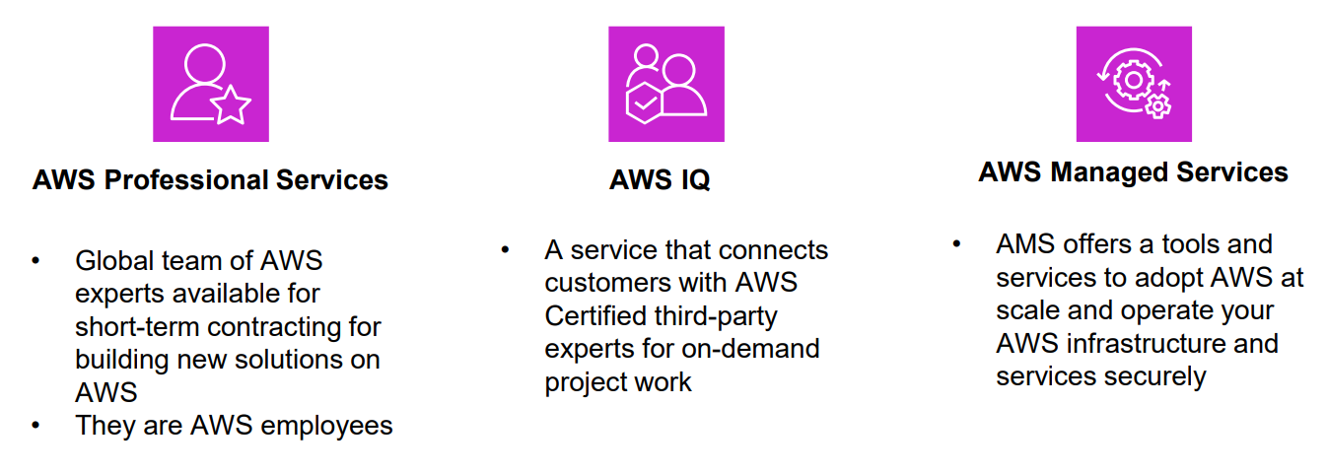
Customer Engagements

Slide 3
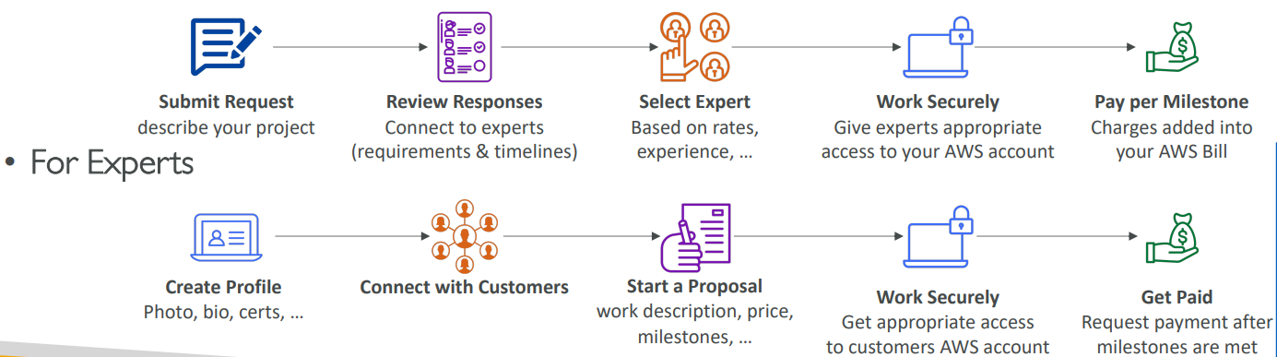
AWS IQ
Quickly find professional help for your AWS projects
Engage and pay AWS Certified 3rd party experts for on-demand project work
Video-conferencing, contract management, secure collaboration, integrated billing
For Customers

Slide 4
AWS Managed Services (AMS)
AMS offers a team of AWS experts who provide services, infrastructure and application support on AWS also manage your Infrastructure for Security, reliability and availability.
Helps organizations offload routine management tasks and focus on their business objectives.
AWS handles common activities such as change requests, monitoring, patch management, security, and backup services
Implements best practices and maintains your AWS infrastructure to reduce your operational overhead and risk
AMS business hours are 24/365

Slide 5
AWS Activate for Start-ups
AWS Activate provides start-ups with a host of benefits, including AWS credits*, AWS support plan credits, and architecture guidance to help grow your business. Activate benefits are designed to give you the right mix of tools, resources, and expert support so you can succeed with AWS while optimizing performance, managing risk, and keeping costs under control.
https://aws.amazon.com/startups

Slide 6
AWS Partner Network
APN Technology Partners: providing hardware, connectivity, and software
APN Consulting Partners: professional services firm to help build on AWS --- Yash Technologies is Consulting Partner
APN Training Partners: find who can help you learn AWS
AWS Competency Program: AWS Competencies are granted to APN Partners who have demonstrated technical proficiency and proven customer success in specialized solution areas.
AWS Navigate Program: help Partners become better Partners

Slide 7
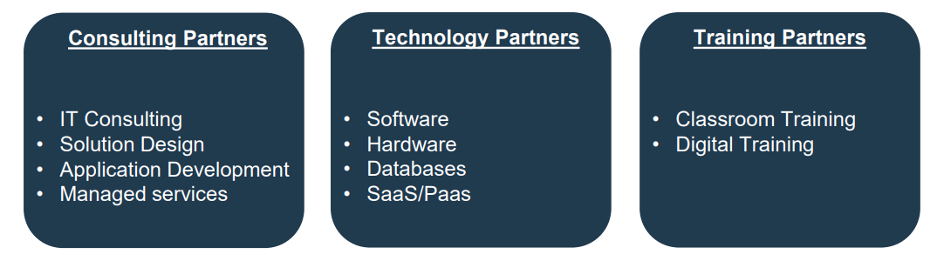
AWS Partner Network

Slide 8
AWS re:post - Ask questions, connect with AWS community
AWS-managed Q&A service offering expert-reviewed answers to your technical questions about AWS that replaces the original AWS Forums
re:Post provides access to curated knowledge and a vibrant community that helps you become even more successful on AWS
Community Driven – like stackoverflow

Slide 9
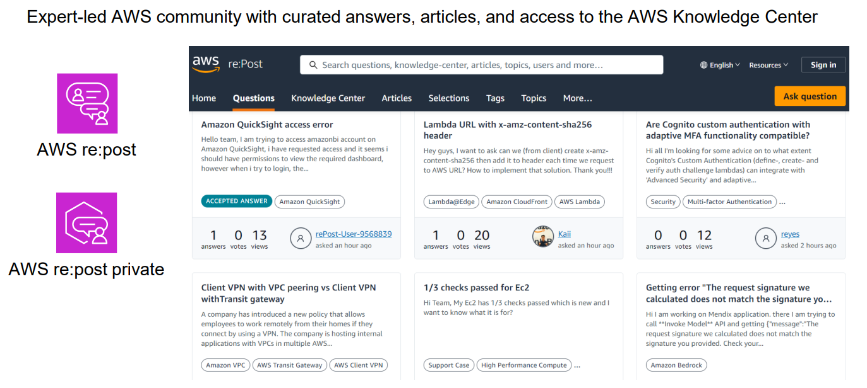
AWS re:post

Slide 10
AWS Knowledge Center
Contains the most frequent & common questions and requests
https://repost.aws/knowledge-center
FAQ

Slide 11
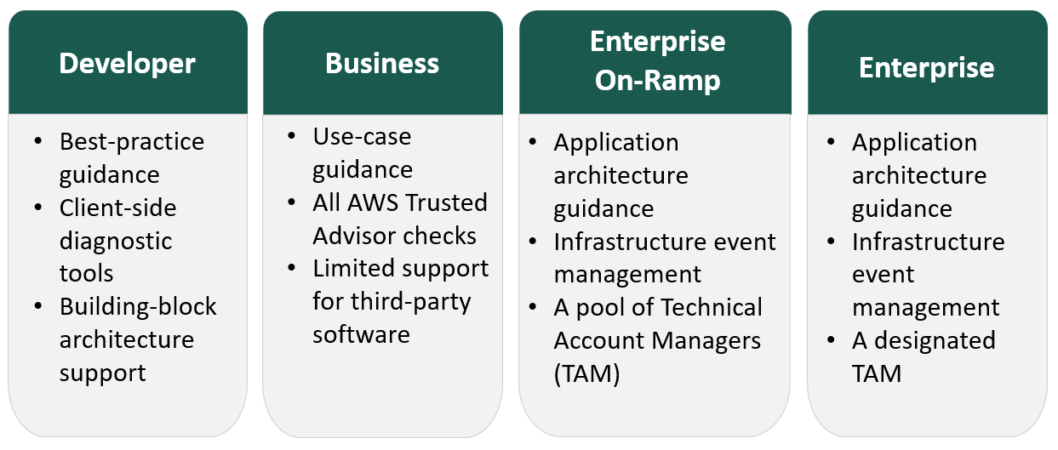
AWS Support Plans

Slide 12
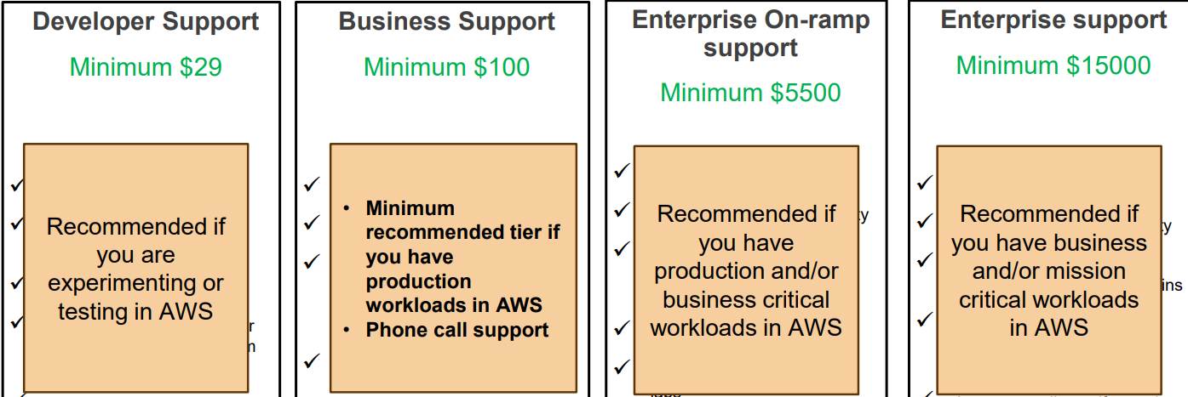
AWS Support Plans

Slide 13
AWS Basic Support Plan
Basic Support is free for all AWS customers and includes access to:
Technical papers, documentation, and support communities
AWS Personal Health Dashboard

Slide 14
Technical Account Manager (TAM)
The Technical Account Manager is your primary point of contact at AWS.
Technical Account Managers are included only with the Enterprise On-Ramp or Enterprise Support plans.
They provide guidance, technical expertise, and best practices.

